Slide 1


SLR Models: Inference

Slide 2

SLR Assessment II: Precision/Inference

Slide 3
Samples Means and Inference: Review

Slide 4
Recall those SLR Assumptions/Conditions

Slide 5
Under those Assumptions/Conditions…

Slide 6
SLR.6: U has a Normal Distribution

Slide 7
Distribution of the OLS Estimators (given SLR.1-SLR.6)

Slide 8
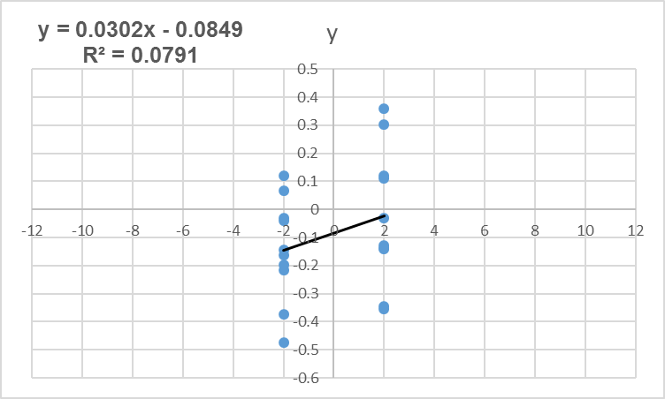
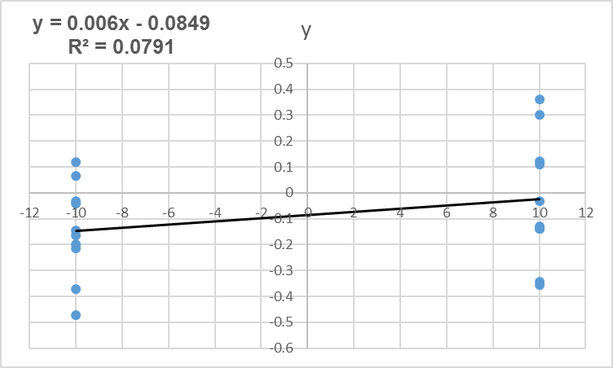
Some Intuition? Why variance in the x’s matters for std errs

Slide 9
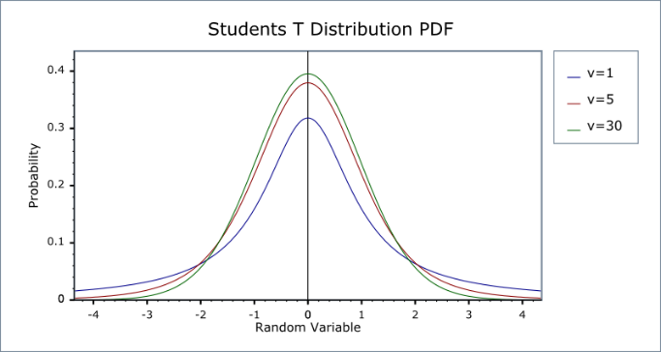
The t Statistic, t Distribution and Confidence Intervals

Slide 10
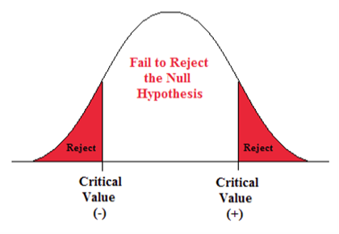
SLR Inference: Hypothesis Testing

Slide 11

p values: Hypothesis tests the easy way

Slide 12
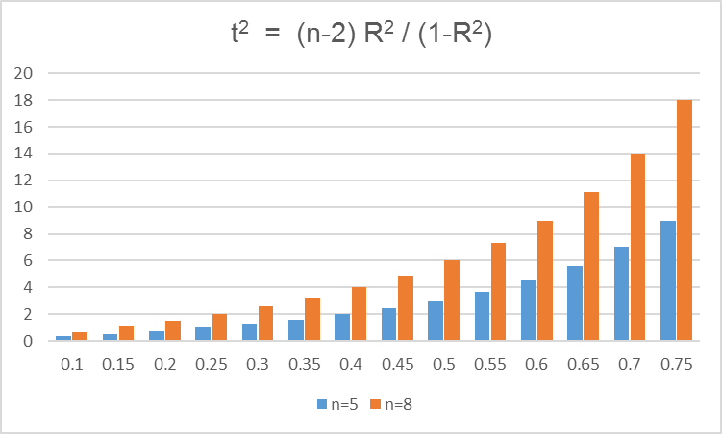
Convergence: SLR Assessment I & II
Who saw this coming?

Slide 13
An Example: Bodyfat

Slide 14
Onwards to MLR Estimation and Inference

